Slide 1
Dutch Whistleblowers’ Authority: Protection of reporting persons and the power of prevention – experience from the Netherlands Wilbert Tomesen Kristien Verbraeken Prague, 17th January 2023

Slide 2
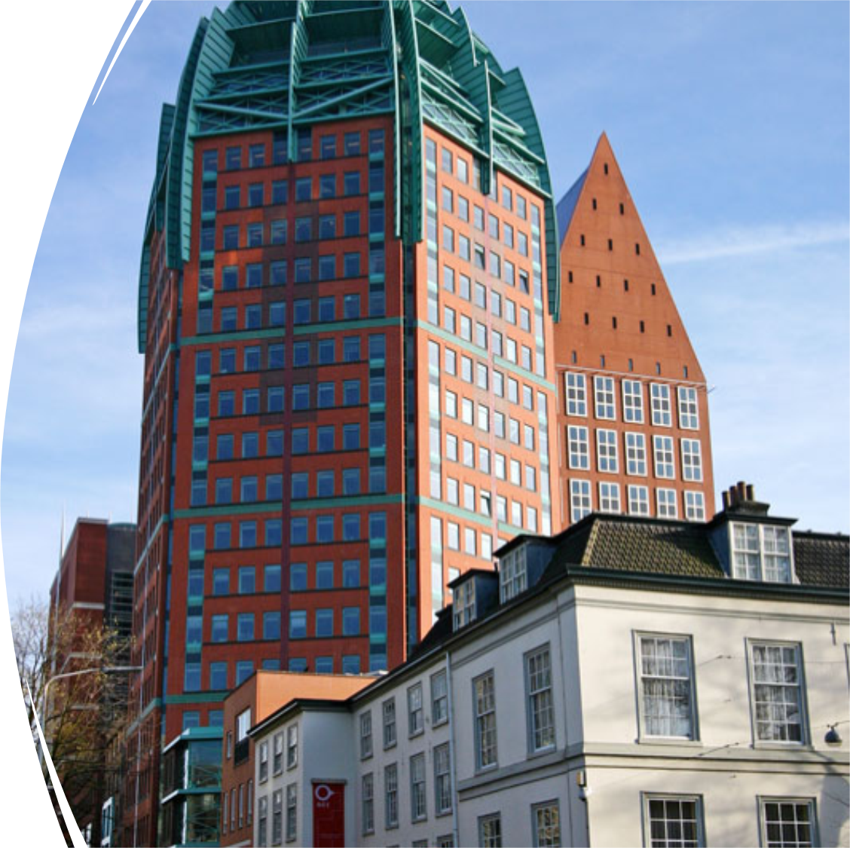
Dutch Whistleblowers’ Authority
2016: law Dutch Whistleblowers’ Authority
2019: EU Directive
2020 evaluation law Dutch Whistleblowers’ Authority
December 2022: draft law Protection of whistleblowers voted on by House of Representatives

Slide 3
Some key features
Established by law, 1 July 2016
Independent State Authority
Minister no power to intervene in internal workings, cases and findings
Reports directly to Parliament
Chair & board members appointed by Royal decree
Office (25-30 FTE)
Board (3)
Departments: Staff/ Advice/ Investigation/ Prevention
External advisory committee
Annual budget: € 4 million
Advice
Investigation
Prevention
Notes:
Prevention of organizational wrongdoing: helping employers to set up an adequate integritity management system (K&P) and reporting procedure
If it does go wrong: providing support to employees on how to report wrongdoings
Investigating serious reports (which harm the public interest) and cases of retaliation

Slide 4
Advice
Guarantee confidentiality/ free of charge
Sounding board for potential reporters and trusted persons
Work-related/ public interest/ proper reporting authority
Assess risks of retaliation/ stress importance of legal aid
Mental support/ referral to professional psychologist
Service letter
No advocacy
Referral to investigation department but is decision of whistleblower

Slide 5
Investigation
Investigate wrongdoings and retaliation
Oversight and inspection agencies come first
Investigative powers: documents + interviews + on-site investigation
Result: publicly published, anonymized report, monitoring advice
No interventions (sanctions, freezing work relationship, dismissal avoidance)

Slide 6
Prevention
Promote integrity management in organizations
Develop and disseminate practical tools & instruments
Brochures, factsheets, online integrity self scan
Conduct research on integrity related topics:
Implementation WB procedure, functioning of trusted persons, integrity management & integrity manager
Presentations and network activities
Notes:
Research: Integrity Measures, Confidential Counsellor, DWA in International Perspective (Kim)
Practical guides: Internal Reporting Procedure, Ethical Culture, tips and tools for Confidential Counsellor (Engl.)

Slide 7
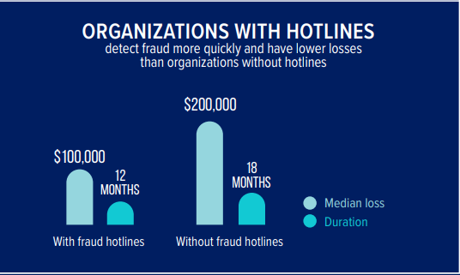
Integrity and whistleblowing in the fight against corruption
Facts and figures: ACFE Report to the nations 2022: https://legacy.acfe.com/report-to-the-nations/2022/
Based on 2,110 cases from 133 countries
Average loss per fraud case: $1,783,000

Slide 8
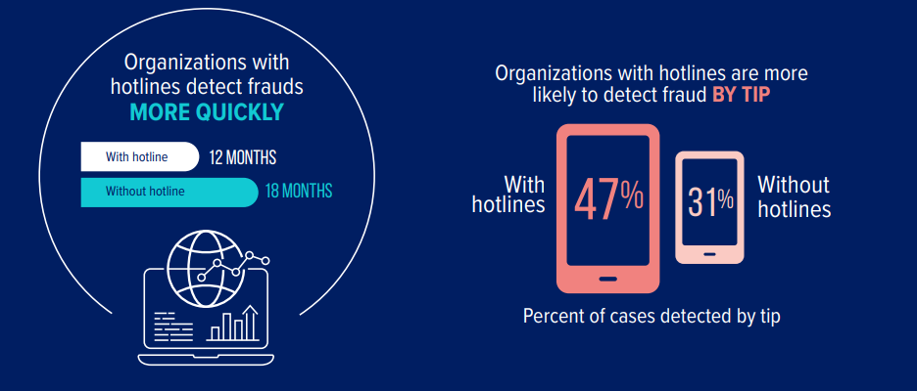
Awareness and training is key

Slide 9
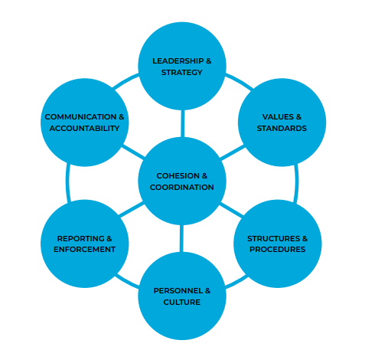
Synergy between whistleblowing and integrity
More demand for integrity
Integrity pays off
Need for integrated and coordinated integrity policy
However, integrity violations might still occur

Slide 10
Effects of non-integrity
Snowballing
Contagion
Radiation
Influences on individual, organizational and societal level

Slide 11
From whistleblowing legislation to successful reporting
Study on crucial factors for successful reporting trajectories 2022 by Utrecht University and Dutch Whistleblowers’ Authority
Success factors and preconditions:
internal reporting procedure meets legal requirements
social and psychological safety
reporting process in accordance with (written/ unwritten) agreements, promises and expectations
openness and transparency
procedure is followed carefully and with speed: decisive and visible action
researchers are knowledgeable and objective, well-intentioned and empathetic
reports and reporting processes systematically evaluated so that lessons can be learned
invest in knowledge, competences, skills and attitude of the actors

Slide 12
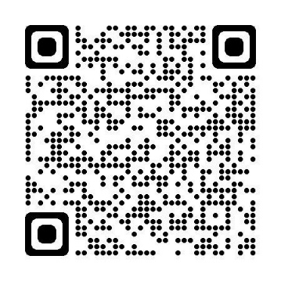
Contact
More information: www.huisvoorklokkenluiders.nl/english
 huisvoorklokkenluiders.nl
 0031 88-133 1000

