Slide 1
NEIWA: Crossborder collaboration and knowledge sharing for better protection of reporting persons Wilbert Tomesen, co-founder of NEIWA International Conference “Strengthening the Fight against Corruption: Whistleblowing” Prague, the Czech Republic 17th January 2023

Slide 2
NEIWA: Network of European Integrity and Whistleblowing Authorities
Mission:
coordinate our efforts towards strengthening the protection of reporting persons in the EU
contribute to strengthening of integrity in working relations, through exchange of knowledge and practices
So far: sharing knowledge on transposition of EU Directive on whistleblower protection and exchange information on practical challenges regarding transposition
Soon, after transposition: exchanging knowledge and information based on real life practice

Slide 3
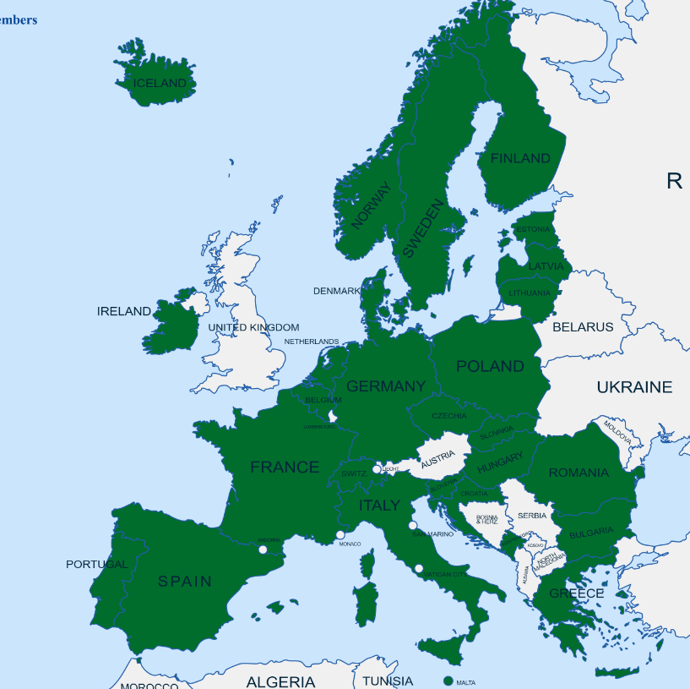
NEIWA members January 2023
Public authorities from EU Member States, EU-candidates and EFTA countries, with a central and / or pivotal role in the field of whistleblowing with the EU Directive 2019/1937 as the common basis
31 authorities from 23 European member states and EFTA (Iceland)
Pending members: Poland, Cyprus, Malta, Norway, Switzerland

Slide 4
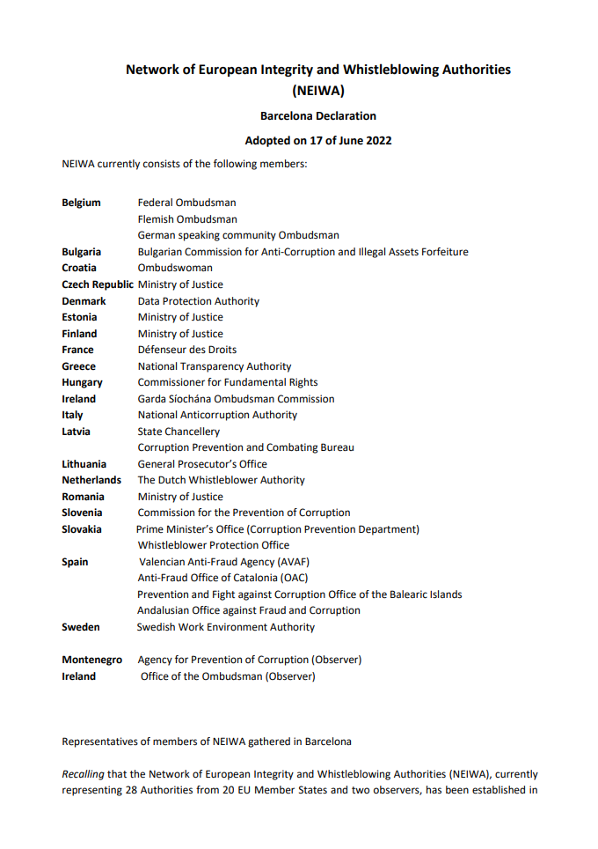
NEIWA speaks up
To keep protection of reporting persons on political and societal agenda
Declarations to mark General Assembly meetings: Paris, Rome, Brussels, Utrecht, Dublin and Barcelona
Propagate recommendations of the declarations, such as:
Ensuring all reporting persons can benefit from effective legal, psychological and financial support when reporting, regardless their financial situation;
Laying down by law the prohibition of retaliation
Extending the scope of application of national laws to (policy) areas that may have a societal impact

Slide 5
Continuous support and learning
Instant support via email
Surveys for instance survey on competences of NEIWA members (Slovakia)
Projects on different topics by working groups
Trainings such as on whistleblower protection law and practice organised by the Garda Ombudsman together with the Maynooth University

Slide 6
Come and join us
www.huisvoorklokkenluiders.nl/samenwerking/internationaal/europees-netwerk

Slide 7
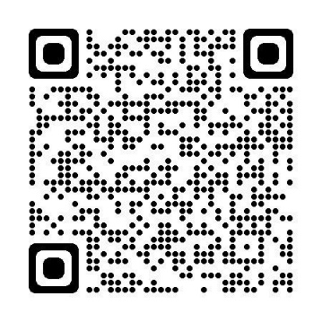
Contact
More information: www.huisvoorklokkenluiders.nl/english
 huisvoorklokkenluiders.nl
 088-133 1000

