Slide 1
Strengthening the Fight Against Corruption: Whistleblowing
Whistleblower’s Experience
Dr Osita Mba

Slide 2
Should Exposing Corruption
Ever Be A Crime?

Slide 3
Public Interest Disclosure Act 1998
A qualifying disclosure means any disclosure of information which tends to show
(a) that a crime may have been committed or
(b) that any law may have been broken.
A disclosure is not a qualifying disclosure if the person making it commits an offence by making it.

Slide 4
Commissioners for Revenue and Customs Act 2005
It is an offence to disclose taxpayer information without authorisation.
Only Commissioners of HMRC can authorise disclosure.
They delegated that power to Dave Hartnett.
Hartnett also had the power (a) to settle large tax cases and (b) to authorise criminal investigation.

Slide 5
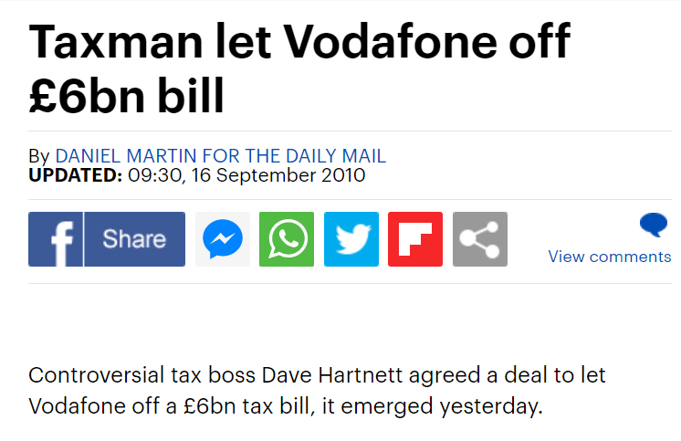

Slide 6
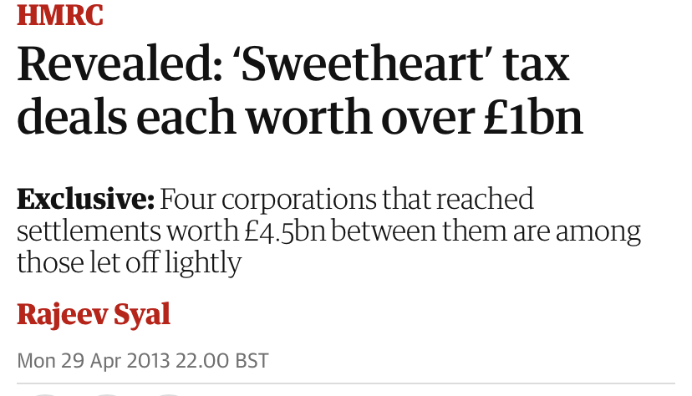

Slide 7
Parliamentary Privilege
Legal immunities for Members of Parliament to perform their duties without outside interference.
Public Accounts Committee
Examines the value for money of Government projects, including taxation.

Slide 8
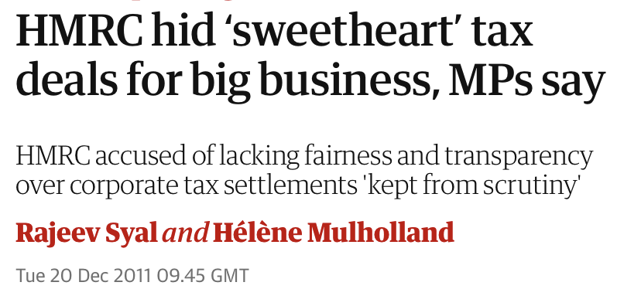

Slide 9
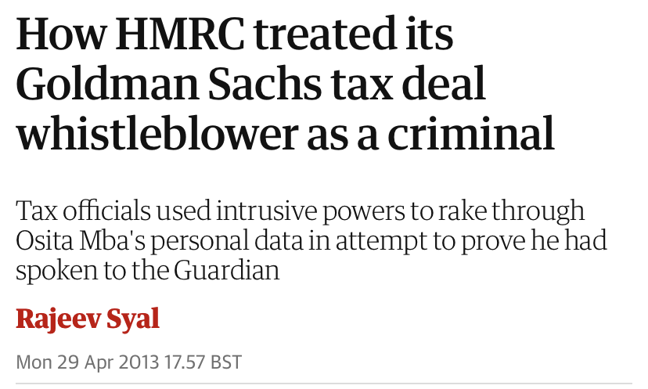

Slide 10
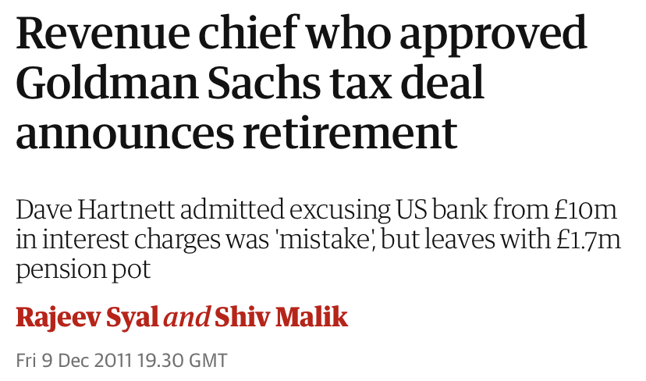

Slide 11
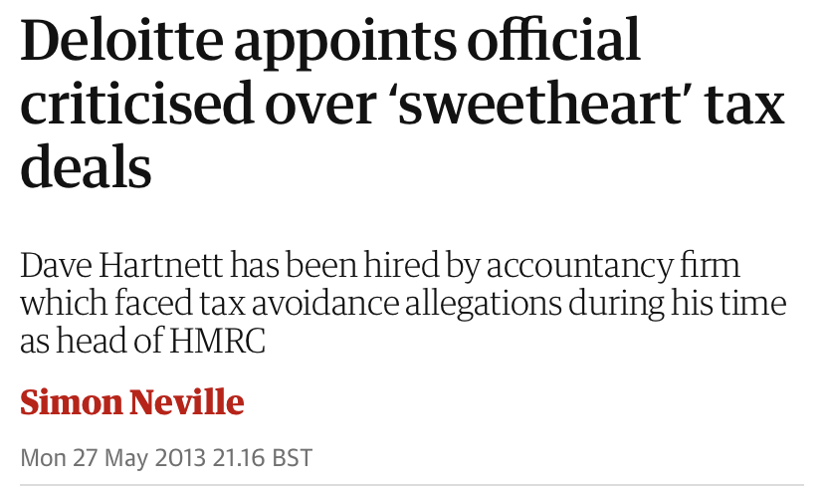

Slide 12
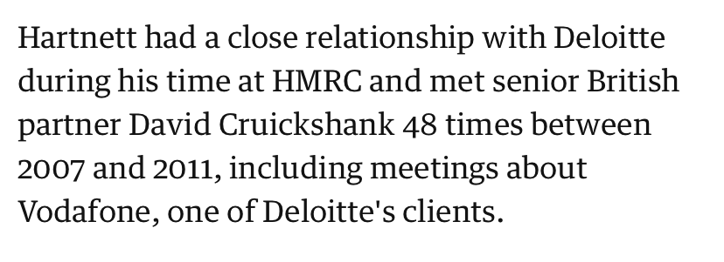

Slide 13
Should Exposing A Crime
Ever Be A Crime?

Slide 14
osita.mba@essex.ac.uk

